Slide 1
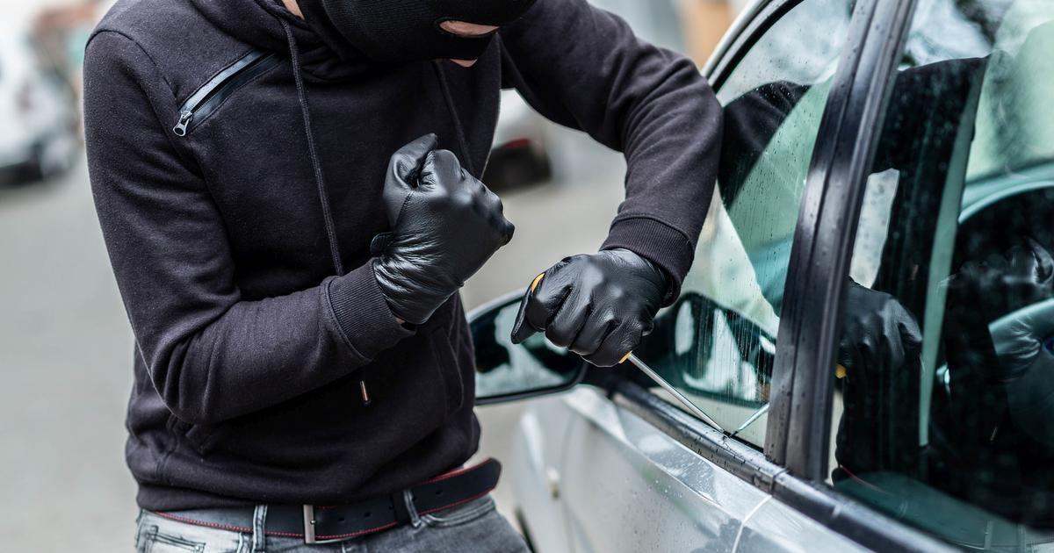
Qualcomm VisionX Hackathon
VigiCar: AI-Powered Vehicle Security
Team: Qual-230350
Deepak Singh
Raghav Rawat
Saksham Gadyal
Ayush Kapoor

Slide 2
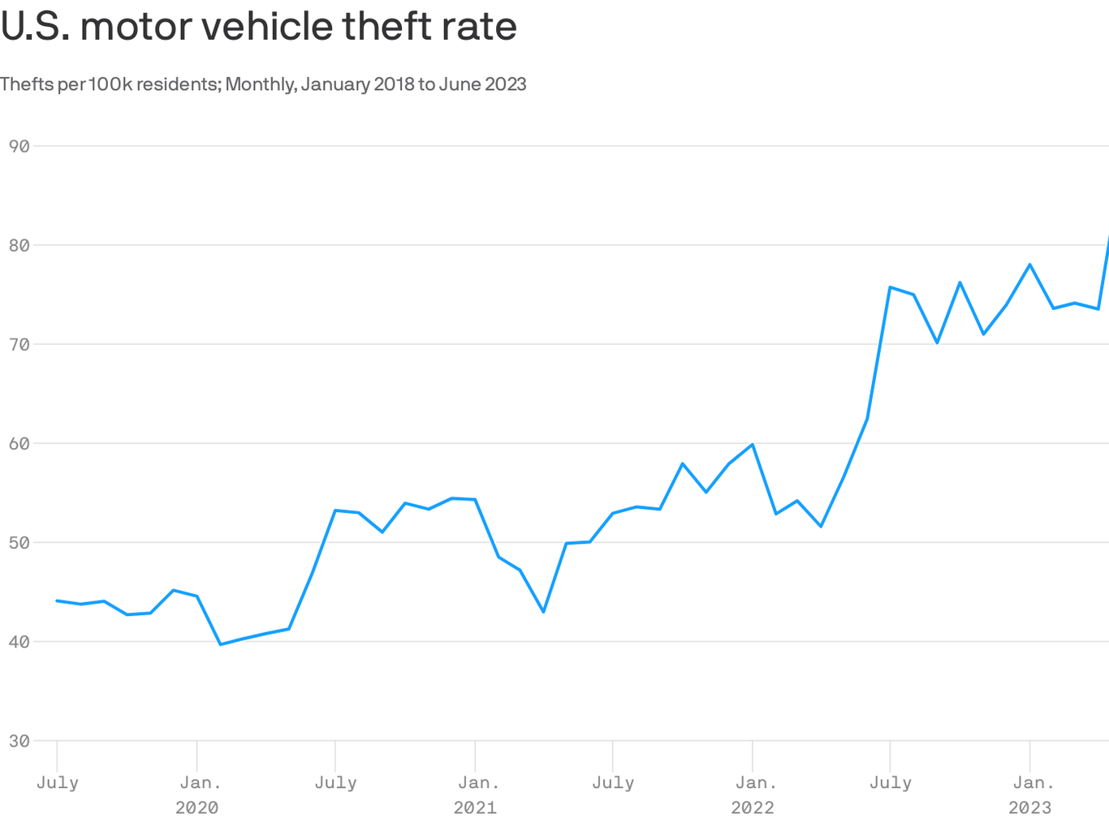
The Rising Tide of Vehicle Theft
Staggering Numbers: In 2023, a record-breaking 1,020,729 vehicles were stolen in the United States alone.14.
Rapid Increase: Vehicle thefts rose by 13.7% between 2020 and 2022, with 999,188 cars stolen in 2022 compared to 878,484 in 2020 3.
Frequency: In 2023, a motor vehicle was stolen every 31 seconds in the U.S. 4
Financial Impact: Stolen vehicles cost Americans approximately $8 billion annually 4.

Slide 3
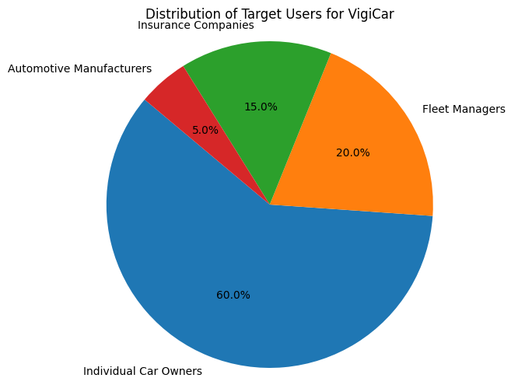
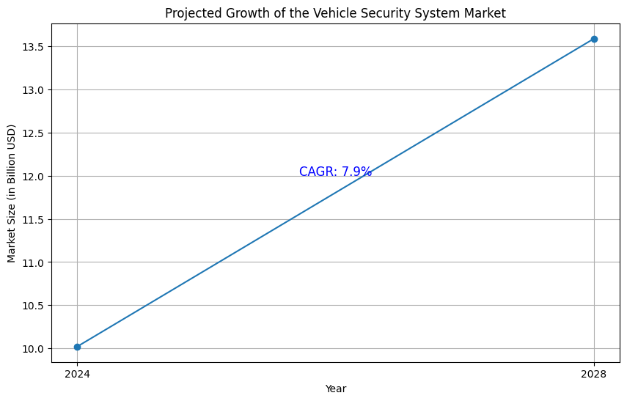
Target Users and Market
Target Users:
• Individual car owners (60%)
• Fleet managers (20%)
• Insurance companies (15%)
• Automotive manufacturers (5%)
Vehicle Security System Market:
• 2024: $10.02 billion
• 2028: $13.59 billion (projected)
• CAGR: 7.9%

Slide 4
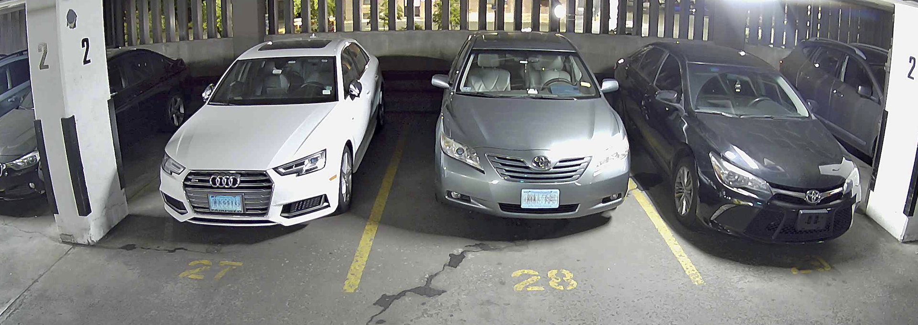
VigiCar
Advanced Roadside Monitoring: AI-powered cameras with License Plate Recognition (LPR) technology capture plates at speeds up to 80 mph across multiple lanes, monitoring parked and moving vehicles 24/7.
Rapid Theft Detection: The system analyzes vehicle behavior patterns and cross-references license plates with databases in real-time, instantly identifying potential thefts for both parked and moving vehicles.
Immediate Alert System: Upon detecting suspicious activity, VigiCar immediately notifies the vehicle owner, local authorities, and designated security teams, providing crucial information and live video feed for swift action.

Slide 5
Technical Architecture
Hardware Components:
High-resolution cameras with night vision capability
Edge computing devices (e.g., NVIDIA Jetson Xavier NX) for on-site processing
Secure cloud servers for data storage and advanced analytics
Software Stack:
Deep learning framework: PyTorch
Computer vision libraries: OpenCV for image processing
YOLO (You Only Look Once) v5 for real-time object detection
Custom-trained neural networks for vehicle and behavior recognition
System Integration:
RESTful APIs for communication between edge devices and cloud servers
Secure WebSocket connections for real-time alerts to mobile devices
Integration with law enforcement databases for license plate verification.

Slide 6
Dataset
Dataset Name | Training Method | Model Usage
Armed CCTV Footage Dataset | Deep learning methods such as YOLO and Faster R-CNN, with detailed approaches focusing on small weapon detection in CCTV footage. | Utilized in real-time weapon detection scenarios, aiding law enforcement in identifying threats in surveillance footage.
ROSPaCe Intrusion Detection Dataset | - | The model is utilized for intrusion detection by analyzing data from multiple architectural layers during normal and attack scenarios. The dataset is used for evaluating the effectiveness of machine learning-based intrusion detection systems in a ROS2-based cyber-physical environment
US Real-time Gun Detection Dataset | Trained using Faster R-CNN with ResNet-50 and Feature Pyramid Networks, leveraging transfer learning techniques. | Utilized for real-time gun detection in CCTV systems to enhance security and public safety.

Slide 7
Creating a Custom Dataset for Intrusion Detection
Data Collection:
Set up multiple surveillance cameras in various parking scenarios (streets, driveways, parking lots)
Record staged intrusion attempts with diverse actors, vehicles, and environmental conditions
Capture normal activities to establish baseline behavior
Ensure coverage of day/night cycles and different weather conditions
Data Annotation:
Label images with bounding boxes around persons, vehicles, and tools
Classify actions: keying, hammering, normal behavior, etc.
Mark timestamps for start and end of suspicious activities
Use professional annotation tools like CVAT or LabelIng for efficiency
Dataset Composition:
Aim for a balanced dataset: 50% normal activities, 50% intrusion attempts
Include at least 1000 instances of each intrusion type (e.g., keying, hammering)
Ensure diversity in vehicle types, camera angles, and lighting conditions
Create separate training, validation, and test sets (70%, 15%, 15% split)
Data Augmentation:
Apply techniques like rotation, flipping, and color jittering to increase dataset variety
Use synthetic data generation to create additional intrusion scenarios
Implement noise injection to simulate low-quality surveillance footage
Privacy and Ethics:
Obtain necessary permissions for data collection in public spaces
Anonymize individuals in the dataset (e.g., blur faces)
Ensure dataset complies with relevant data protection regulations

Slide 8
Data Preprocessing
Normalization: Standardize image sizes and formats across all datasets
Augmentation: Apply techniques like rotation, flipping, and color adjustments
Annotation: Label images with bounding boxes for cars, people, and tools
Action Labeling: Classify each frame or sequence with specific actions

Slide 9
Training Methodology for VigiCar Intrusion Detection System
Dataset Split: 70% training, 15% validation, 15% test
Multi-stage Training:
Train on existing surveillance datasets for general object detection
Fine-tune on our custom VigiCar dataset for specific car theft actions
Loss Function: Combination of object detection loss and action classification loss
Validation and Testing:
Cross-validation: Use k-fold cross-validation on the training set
Hold-out Test Set: Evaluate on unseen data from our custom dataset
Real-world Testing: Conduct tests in actual parking scenarios
Iterative Improvement:
Error Analysis: Identify common misclassifications and failure modes
Dataset Expansion: Continuously add new scenarios to the VigiCar dataset
Model Refinement: Regularly update the model architecture and weights

Slide 10
Deployment Considerations:
Model Optimization: Use techniques like pruning and quantization for efficient deployment
Edge Computing: Adapt model for running on edge devices near surveillance cameras
Privacy Measures: Implement data anonymization techniques in the deployed system

Slide 11
Expected Outcomes:
a) Detection Capabilities:
Accurate identification of suspicious activities around parked vehicles
Differentiation between normal behavior and potential theft attempts
Real-time alerting system for immediate response
b) Model Performance:
Aim for high precision and recall in identifying key actions (e.g., keying, window breaking)
Minimize false positives to avoid unnecessary alerts
Achieve real-time processing speeds suitable for live video feeds
c) Scalability and Adaptability:
System that can be deployed across various parking environments
Ability to handle different lighting conditions and weather scenarios

Slide 12
Key Challenges to Address:
Creating a comprehensive and diverse dataset for training
Balancing model complexity with real-time performance requirements
Ensuring privacy compliance in surveillance applications
Developing strategies to handle occlusions and partial views in crowded parking areas
Next Steps:
a) Dataset Development:
Collect and annotate a large, diverse set of surveillance footage
Ensure representation of various theft scenarios and normal activities
b) Model Training and Optimization:
Implement and train the Faster R-CNN model on our custom dataset
Experiment with hyperparameters to balance accuracy and speed
c) Testing and Validation:
Conduct thorough testing in controlled environments
Plan for real-world pilot tests in actual parking scenarios
d) Integration and Deployment:
Develop interfaces for security personnel and vehicle owners
Explore integration possibilities with existing security infrastructure

